Slide 1
DATA606 – Statistics and Probability for Data Analytics Spring 2021
Final Data Project Peter Gatica

Slide 2
Part 1 – Introduction ABSTRACT
The purpose of this project is to explore the possible reasons that citizens in countries around the world consume alcohol. After reviewing the alcohol consumption dataset, I did not see a meaningful way on how to run and interpret any linear models. I will admit that this may be due to my inexperience with data analytics. I found myself wondering what factors contribute to the consumption of alcohol in all countries. Is there a correlation between certain factors like economic freedom, religious freedom or freedom of expression, or overall happiness with one’s life? I then thought that I would combine this dataset with a subset of data from the Human Freedom Index dataset for 2010. I downloaded both the datasets from FiveThirtyEight and the CATO Institute for 2010 respectively. I then manually combined variables from both datasets to use for my final project research. I matched the data from both sources by country, taking personal freedom, economic freedom, and the overall happiness scores from each country and, matching by country, I took beer, wine, spirit servings and total alcohol consumption in liters per person. I omitted any records that contained an N/A in fields to avoid inaccurate estimates in my linear models. I proceeded to run linear models on how happiness scores affect the amount of alcohol consumption for each country in the dataset. I did the same for each personal freedom and economic freedom scores. I also interpret the correlation coefficient and R-squared results for each model. I believe that this kind of research can be very useful around the world to identify countries that may have a propensity for alcohol abuse and create programs to help curtail alcoholism and perhaps other health and social issues that may result from alcohol abuse.

Slide 3
Part 2 – Data Data Sources
FiveThirtyEight - The dataset that I am using as one of my sources was found at the FiveThirtyEight github link. This dataset on alcohol consumption by country for 2010 is the data behind the article Dear Mona Followup:Where Do People Drink The Most Beer, Wine and Spirits. The data was collected by the World Health Organization
The Human Freedom Index presents the state of human freedom in the world based on a broad measure that encompasses personal, civil, and economic freedom. Human freedom is a social concept that recognizes the dignity of individuals and is defined here as negative liberty or the absence of coercive constraint. Because freedom is inherently valuable and plays a role in human progress, it is worth measuring carefully. The Human Freedom Index is a resource that can help to more objectively observe relationships between freedom and other social and economic phenomena, as well as the ways in which the various dimensions of freedom interact with one another.
The report is co‐published by the Cato Institute and the Fraser Institute.

Slide 4
Data collection
Description of the dependent variable (what is being measured?)
The response variable is the amount of alcohol (liters) consumed per person by country in 2010 and the variable is numerical.
Description of the independent variable (what is being measured?, include at least 2 variables)
The explanatory variables are happiness score (hf_score), personal freedom score (pf_score), and economic freedom score (ef_score). Personal freedom and economic scores contribute to the overall happiness score of a country’s citizens. All are numerical.
Research question
Does the happiness factor score of a country’s citizens affect the amount of alcohol consumed by that country? How do personal expression and economic freedoms affect the amount of alcohol consumed by an individual in certain countries?
Type of study
This is an observational study.

Slide 5
Summary Statistics of source dataset
## year ISO_code countries region ## Min. :2010 Length:147 Length:147 Length:147 ## 1st Qu.:2010 Class :character Class :character Class :character ## Median :2010 Mode :character Mode :character Mode :character ## Mean :2010 ## 3rd Qu.:2010 ## Max. :2010 ## pf_rol pf_religion_restrictions pf_religion pf_expression_control ## Min. :3.100 Min. : 3.056 Min. :4.291 Min. :0.750 ## 1st Qu.:4.309 1st Qu.: 6.250 1st Qu.:7.188 1st Qu.:3.750 ## Median :5.100 Median : 7.778 Median :8.096 Median :5.250 ## Mean :5.465 Mean : 7.455 Mean :7.943 Mean :5.325 ## 3rd Qu.:6.517 3rd Qu.: 8.889 3rd Qu.:8.952 3rd Qu.:7.250 ## Max. :8.700 Max. :10.000 Max. :9.944 Max. :9.250 ## pf_expression pf_score pf_rank ef_money_inflation ## Min. :3.269 Min. :4.489 Min. : 1.00 Min. :4.188 ## 1st Qu.:6.855 1st Qu.:6.353 1st Qu.: 38.50 1st Qu.:8.718 ## Median :8.138 Median :7.318 Median : 77.00 Median :9.238 ## Mean :7.849 Mean :7.311 Mean : 76.92 Mean :9.033 ## 3rd Qu.:9.128 3rd Qu.:8.563 3rd Qu.:115.50 3rd Qu.:9.642 ## Max. :9.750 Max. :9.562 Max. :153.00 Max. :9.869 ## ef_money_currency ef_money ef_score ef_rank ## Min. : 0.000 Min. :1.972 Min. :3.96 Min. : 2.00 ## 1st Qu.: 5.000 1st Qu.:6.947 1st Qu.:6.24 1st Qu.: 38.00 ## Median :10.000 Median :8.245 Median :6.85 Median : 77.00 ## Mean : 6.531 Mean :8.038 Mean :6.75 Mean : 77.18 ## 3rd Qu.:10.000 3rd Qu.:9.305 3rd Qu.:7.35 3rd Qu.:115.50 ## Max. :10.000 Max. :9.887 Max. :8.76 Max. :153.00 ## hf_score hf_rank hf_quartile beer_servings ## Min. :4.909 Min. : 2.00 Min. :1.000 Min. : 0.0 ## 1st Qu.:6.405 1st Qu.: 39.50 1st Qu.:1.500 1st Qu.: 27.0 ## Median :6.950 Median : 77.00 Median :2.000 Median : 85.0 ## Mean :7.030 Mean : 76.98 Mean :2.497 Mean :119.7 ## 3rd Qu.:7.868 3rd Qu.:115.00 3rd Qu.:3.500 3rd Qu.:204.5 ## Max. :8.879 Max. :153.00 Max. :4.000 Max. :376.0 ## spirit_servings wine_servings total_litres_of_pure_alcohol ## Min. : 0.00 Min. : 0.00 Min. : 0.000 ## 1st Qu.: 8.00 1st Qu.: 1.00 1st Qu.: 1.800 ## Median : 69.00 Median : 9.00 Median : 4.900 ## Mean : 82.77 Mean : 55.63 Mean : 5.159 ## 3rd Qu.:128.50 3rd Qu.: 82.50 3rd Qu.: 8.200 ## Max. :326.00 Max. :370.00 Max. :12.900

Slide 6
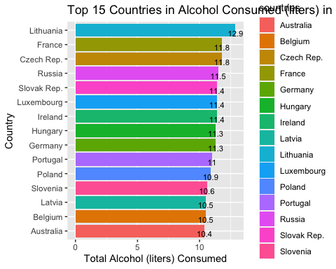
Part 3 - Exploratory Data Analysis Appropriate Visualizations The bar graph shows the top 15 countries in alcohol consumption (liters) per person in 2010. head(alc_hfi_2010[order(-alc_hfi_2010$total_litres_of_pure_alcohol),],15) %>% ggplot(aes(y=reorder(countries,total_litres_of_pure_alcohol),x=total_litres_of_pure_alcohol,fill=countries)) + geom_bar(stat = 'identity',position=position_dodge()) + geom_text(aes(label=total_litres_of_pure_alcohol), vjust=1.0, color="black", position = position_dodge(0.9), size=3.0) + labs(x = ("Total Alcohol (liters) Consumed"),y = ("Country"), title = ("Top 15 Countries in Alcohol Consumed (liters) in 2010 per Person") ) theme_minimal()

Slide 7
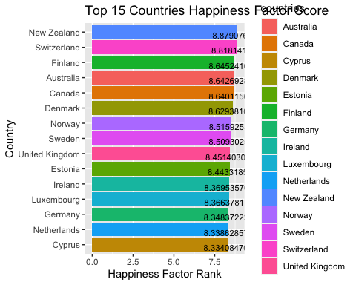
The bar graph shows the 15 countries with highest happiness score in 2010.
head(alc_hfi_2010[order(-alc_hfi_2010$hf_score),],15) %>% ggplot(aes(y=reorder(countries,hf_score),x=hf_score,fill=countries)) + geom_bar(stat = 'identity',position=position_dodge()) + geom_text(aes(label=hf_score), vjust=1.0, color="black", position = position_dodge(0.9), size=3.0) + labs(x = ("Happiness Factor Rank"),y = ("Country"), title = ("Top 15 Countries Happiness Factor Score") )
theme_minimal()

Slide 8
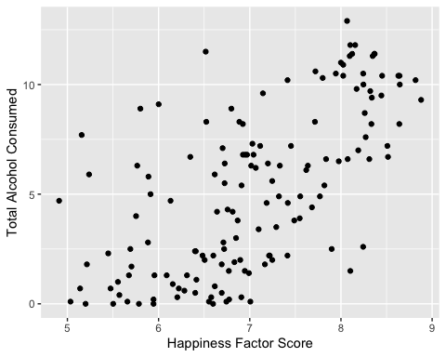
Statistical Output
An initial glance at the scatterplot below does show a possible linear correlation between the happiness factor and the total alcohol consumed (liters) per person. The plots are widespread and are not tightly packed. The relationship looks linear and we can quantify the strength of the relationship with the correlation coefficient.
ggplot(data = alc_hfi_2010, aes(x = hf_score, y = total_litres_of_pure_alcohol)) + geom_point() + labs(x = ("Happiness Factor Score"),y = ("Total Alcohol Consumed"))
theme_minimal()

Slide 9
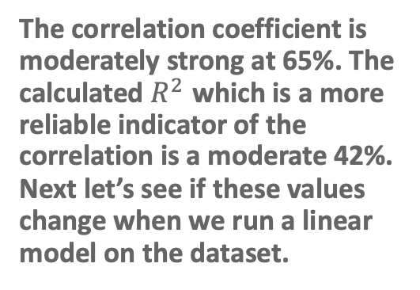
cor(hf_score, total_litres_of_pure_alcohol, use = "complete.obs")
> 1 0.6465383
The correlation coefficient is moderately strong at 65%. The calculated $R^{2}$ which is a more reliable indicator of the correlation is a moderate 42%. Next let’s see if these values change when we run a linear model on the dataset.

Slide 10
The Happiness Factor
Is the amount of a country’s alcohol consumption affected by how happy its citizens are?
In my dataset there is a happiness factor score of countries around the world. This happiness factor score is based on certain variables such as freedom of expression, freedom of religion and economic freedom to name a few. There many more variables that go into the happiness factor score but for purposes of this project I will only consider the ones I just mentioned and extracted.
The happiness factor to alcohol linear model
## ## Call: ## lm(formula = total_litres_of_pure_alcohol ~ hf_score, data = alc_hfi_2010) ## ## Coefficients: ## (Intercept) hf_score ## -12.191 2.468
## ## Call: ## lm(formula = total_litres_of_pure_alcohol ~ hf_score, data = alc_hfi_2010) ## ## Residuals: ## Min 1Q Median 3Q Max ## -6.3058 -2.0845 -0.4203 1.8400 7.6080 ## ## Coefficients: ## Estimate Std. Error t value Pr(>|t|) ## (Intercept) -12.1911 1.7161 -7.104 5.05e-11 *** ## hf_score 2.4679 0.2418 10.205 < 2e-16 *** ## --- ## Signif. codes: 0 '***' 0.001 '**' 0.01 '*' 0.05 '.' 0.1 ' ' 1 ## ## Residual standard error: 2.831 on 145 degrees of freedom ## Multiple R-squared: 0.418, Adjusted R-squared: 0.414 ## F-statistic: 104.1 on 1 and 145 DF, p-value: < 2.2e-16
Running a linear model verifies that there is a slightly moderate correlation of 41.4% between a country’s happiness score and the amount of alcohol that its citizens consume.

Slide 11
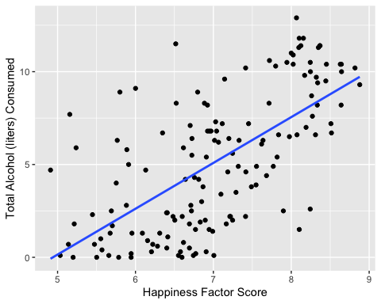
The scatterplot with the least sum of the squares line can illustrate that correlation. It does show a positive linear relationship, however, based on how the points are not tightly packed along the blue line suggests that there is not an overly strong correlation. Let’s next look at the correlation between alcohol consumption and personal freedom.

Slide 12

Personal Freedom Factor
When considering the personal freedom score alone, the correlation coefficient is stronger at 69.5%. The calculated $R^{2}$ which is a more reliable indicator of the correlation increases to 48.3%.
## cor(pf_score, total_litres_of_pure_alcohol, use = "complete.obs") ## 1 0.6954629
The personal freedom factor alcohol linear model
## ## Call: ## lm(formula = total_litres_of_pure_alcohol ~ pf_score, data = alc_hfi_2010) ## ## Coefficients: ## (Intercept) pf_score ## -9.344 1.984
## ## Call: ## lm(formula = total_litres_of_pure_alcohol ~ pf_score, data = alc_hfi_2010) ## ## Residuals: ## Min 1Q Median 3Q Max ## -5.4087 -1.9192 -0.1873 1.8010 7.9620 ## ## Coefficients: ## Estimate Std. Error t value Pr(>|t|) ## (Intercept) -9.3442 1.2637 -7.394 1.05e-11 *** ## pf_score 1.9838 0.1702 11.655 < 2e-16 *** ## --- ## Signif. codes: 0 '***' 0.001 '**' 0.01 '*' 0.05 '.' 0.1 ' ' 1 ## ## Residual standard error: 2.666 on 145 degrees of freedom ## Multiple R-squared: 0.4837, Adjusted R-squared: 0.4801 ## F-statistic: 135.8 on 1 and 145 DF, p-value: < 2.2e-16
Running a linear model on the personal freedom score alone verifies that there is a more moderate $R^{2}$ of 48% between a country’s personal freedom score and the amount of alcohol that its citizens consume.

Slide 13
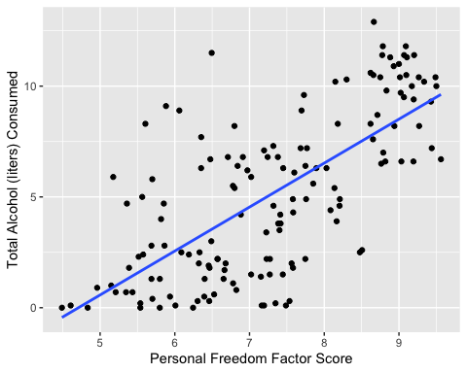
The scatterplot with the least sum of the squares line does show the points are little more tightly packed along the blue line which suggests a more constant variability than the happiness factor correlation. Finally, let’s explore the correlation between alcohol consumption and economic freedom.

Slide 14

Economic Freedom Factor
Considering the economic freedom score alone, the correlation coefficient is lower at 41.6%. The calculated $R^{2}$ which is a more reliable indicator of the correlation drops to a 17% suggesting a very low correlation between economic freedom and the amount of alcohol that a person consumes.
## cor(ef_score, total_litres_of_pure_alcohol, use = "complete.obs") ## 1 0.415568
The economic factor alcohol linear model
## ## Call: ## lm(formula = total_litres_of_pure_alcohol ~ ef_score, data = alc_hfi_2010) ## ## Coefficients: ## (Intercept) ef_score ## -7.118 1.819
## ## Call: ## lm(formula = total_litres_of_pure_alcohol ~ ef_score, data = alc_hfi_2010) ## ## Residuals: ## Min 1Q Median 3Q Max ## -7.3156 -3.1323 0.1963 2.5361 7.6150 ## ## Coefficients: ## Estimate Std. Error t value Pr(>|t|) ## (Intercept) -7.1177 2.2488 -3.165 0.00189 ** ## ef_score 1.8189 0.3306 5.502 1.66e-07 *** ## --- ## Signif. codes: 0 '***' 0.001 '**' 0.01 '*' 0.05 '.' 0.1 ' ' 1 ## ## Residual standard error: 3.375 on 145 degrees of freedom ## Multiple R-squared: 0.1727, Adjusted R-squared: 0.167 ## F-statistic: 30.27 on 1 and 145 DF, p-value: 1.657e-07
Running a linear model on the economic freedom score alone verifies that there is a very weak $R^{2}$ of 16.7% between a country’s economic freedom score and the amount of alcohol that its citizens consume.

Slide 15
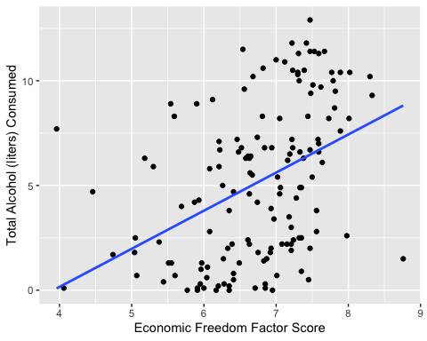
The scatterplot with the least sum of the squares line show this weak correlation. One can see that the points are widely scattered and do not run a long the length of the blue as do the prior two models.

Slide 16
Part 4 Conclusion
I was surprised to find that the happiness factor for each country did not have a much stronger correlation to the amount of alcohol consumed by its citizens. It was only a moderate correlation. I had expected to see a tighter gathering around the sum of the least squares line showing that people with a lower happiness factor drank more. This was not the case in any of the scenarios as shown by the higher negative residuals at the lower ends of the plots. I also expected that the higher a happiness factor would decrease the amount of alcohol consumed by persons, however, it was the opposite. The higher the happiness factor the more positive residuals there are.

Slide 17
Why is the analysis important?
I believe that this kind of research can be very useful around the world to identify countries that may have a propensity for alcohol abuse and create programs to help curtail alcoholism and perhaps other health and social issues that may result from alcohol abuse.

Slide 18
Limitations of the analysis?
I have to admit that the limitations of the analysis is reflective of my experience with data analystics and visualization. With more experience, I could easily apply the mutiple variable method of linear modeling for more accurate determination of the correlation between the different happiness index factors and a country’s alcohol consumption by its citizens. I certainly would delve more into which of the different factors are the greater contributors to alcohol consumption. My attempt is a very elementary one at best.

Slide 19
References
Dear Mona is Mona Chalabi, a former contributor on FiveThirtyEight posting articles that answer readers’ questions as well as postings regarding data and data analytics.

Slide 20
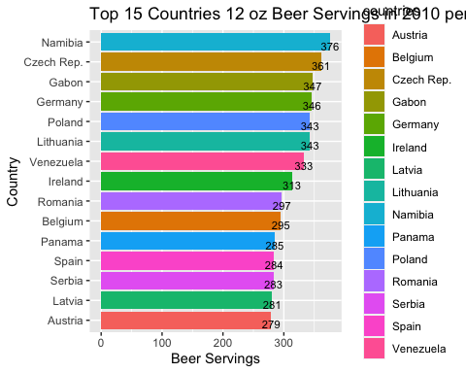
Appendix
Bar graph of the top 15 countries with the highest beer consumption per person in 2010.
head(alc_hfi_2010[order(-alc_hfi_2010$beer_servings),],15) %>% ggplot(aes(y=reorder(countries,beer_servings),x=beer_servings,fill=countries)) + geom_bar(stat = 'identity',position=position_dodge()) + geom_text(aes(label=beer_servings), vjust=1.0, color="black", position = position_dodge(0.9), size=3.0) + labs(x = ("Beer Servings"),y = ("Country"), title = ("Top 15 Countries 12 oz Beer Servings in 2010 per Person") )
theme_minimal()

Slide 21
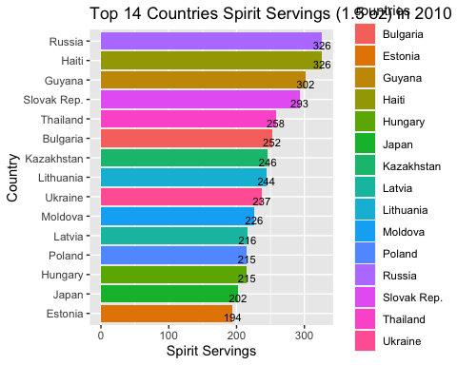
Bar graph of the top 15 countries with the highest spirits consumption per person in 2010.
head(alc_hfi_2010[order(-alc_hfi_2010$spirit_servings),],15) %>% ggplot(aes(y=reorder(countries,spirit_servings),x=spirit_servings,fill=countries)) + geom_bar(stat = 'identity',position=position_dodge()) + geom_text(aes(label=spirit_servings), vjust=1.0, color="black", position = position_dodge(0.9), size=3.0) + labs(x = ("Spirit Servings"),y = ("Country"), title = ("Top 14 Countries Spirit Servings (1.5 oz) in 2010 per Person") )
theme_minimal()

Slide 22
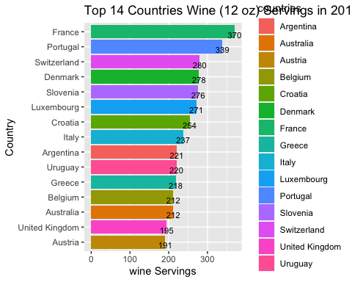
Bar graph of the top 15 countries with the highest wine consumption per person in 2010.
head(alc_hfi_2010[order(-alc_hfi_2010$wine_servings),],15) %>% ggplot(aes(y=reorder(countries,wine_servings),x=wine_servings,fill=countries)) + geom_bar(stat = 'identity',position=position_dodge()) + geom_text(aes(label=wine_servings), vjust=1.0, color="black", position = position_dodge(0.9), size=3.0) + labs(x = ("wine Servings"),y = ("Country"), title = ("Top 14 Countries Wine (12 oz) Servings in 2010 per Person") )
theme_minimal()

